Slide 1
Bosch TMC Leakage Reduction

Slide 2
Project Charter
Purpose (what):
Reduce Leakage incidents for TMC castings
Goal Statement (why):
The TMC casting jobs are sent to the customer without machining; the customer machines them in-house, which makes defect identification difficult for us
Business Impact:
AVG TMC (LEAKAGE) PPM (Y2020): 371
In Scope:
Bosch TMC
Schedule/ Milestones:
Problem Definition
Primary Analysis
Trial Set-up
Trial Conduction (Conduct radiography tests for 30 sample, 8 components for all trials and calculate % defect rate)- April-21 till Aug-21
Results Analysis (ANOVA & DOE)- Aug-21
Verification Experiment - Aug-21
Deliverables:
Zero customer complaints for TMC leakage
Resources:
Metallurgy Lab/Radiography Machine/Leakage Testing Set-up
Project Sponsors: Sudhir Divekar
Core Team: Alok Mishra, Harshit Agrawal, Nitin Jagtap, Anil More
Category | Impact | Remarks
Frequency | Low | Low volume defect; YTD leakage under 0.1% for all components but RE-60 TMC
Detection | High | Currently un-machined jobs sent out directly to Bosch; defects are opened after machining
Severity | High | Bosch performs leakage testing after machining in their plant, identifies leakage and files complaints

Slide 3
Monthly Defect Trend – TMC Leakage
2020
2021

Slide 4
Component wise Defects YTD

Slide 5
Primary Analysis
Shrinkage
Last to solidify area
Abrupt changes in the geometry
Leakage
Creation of hot spot
Spongy Shrinkage
Inclusion
Aluminium Oxide
Aluminium Foil
Single layer
Multiple layers
Dross
Unclean metal
Ineffective Filtration
FACTOR TAKEN INTO ACCOUNT

Slide 6
Control Factors
Control factors below are based on both spongy shrinkage and Inclusion
Sr. No. | Control Factor | Category | Unit | Lower Limit | Base Level | Upper Limit | Tolerance | Remarks if any
1 | Pouring Temperature | Shrinkage | Degree C | 690 | 710 | 730 | 5 | Improve/Reduce rate of heat transfer which dominates shrinkage defects
2 | Cu Concentration | Shrinkage | % | 3.6 | 3.8 | 4 | 0.05 | Cu-Si-Ti are major additives in the alloy mix; they play a major role in metallurgical and shrinkage properties of parts due to heat conduction/transfer
3 | Si Concentration | Shrinkage | % | 4.6 | 5.0 | 5.4 | 0.10
4 | Ti Concentration | Shrinkage | % | 0.09 | 0.14 | 0.19 | 0.01
5 | Cup coating frequency | Inclusion | count | Once in shift | Once in shift | Twice in a shift |  | Coating prevents in material getting stuck up in the cup
6 | Mg Concentration | Inclusion (Oxidation) | % | 0.07 | 0.12 | 0.18 | 0.01 | Mg concentration important to study the oxidation in aluminium alloy
7 | Cup cleaning frequency | Inclusion | count | Once in shift | once in a shift | Twice in a shift |  | Cleaning prevents in material getting stuck up in the cup
8 | Flux powder Quantity | Inclusion | gm | 500 | 600 | 700 | 25 | Specification is 600±60, but taking the values as 500~700.

Slide 7
Control Factors
Control factors below are based on shrinkage
Sr. No. | Control Factor | Category | Unit | Lower Limit | Base Level | Upper Limit | Tolerance | Remarks if any
1 | Pouring Temperature | Shrinkage | Degree C | 685 | 710 | 725 | 5 | Improve/Reduce rate of heat transfer which dominates shrinkage defects
2 | Cu Concentration | Shrinkage | % | 3.6 | 3.8 | 4 | 0.05 | Cu-Si-Ti are major additives in the alloy mix; they play a major role in metallurgical and shrinkage properties of parts due to heat conduction/transfer
3 | Si Concentration | Shrinkage | % | 4.6 | 5.0 | 5.4 | 0.10
4 | Ti Concentration | Shrinkage | % | 0.09 | 0.14 | 0.19 | 0.01

Slide 8
Way Ahead
Based on the control factors on #6 and their settings/levels, trials will to be conducted.
Based on the feasibility, a suitable output measurement will be recorded for every trial.
After the output levels are recorded through experiments, the influence of the control factors on leakage will be determined using ANOVA (Analysis of Variance)
Once the influential control factors are identified, their optimum setting/level will be calculated using DOE.
For n settings with 3 levels each, Design For Six Sigma (DFSS) would require 3^{n} trials
Taguchi DOE is more suitable due to time and resource constraints (Max 18 trials). It does not compromise results.
NOTE: The effectiveness of the DOE/ANOVA depends on the control factors selected and their settings taken into consideration for trials.

Slide 9
Trial Setup
DATA SHEET
There is constraint in conducting all the experiments at once. High level of preparation is required beforehand which will effect our regular production.
We have tried clubbing as many experiments together as possible.
For each trial 15 shots per job will be taken conducting over 8 dies simultaneously. This will account for ¬300 kgs of melt for each trial and a preparation of 1 MT furnace need to be done for this.

Slide 10
TEAM WORK
DIE MAINTENANCE (ANW/RDR)
Ensure there is no defect due to die
TEAMS INVOLVED
Preparation of dies according to die plan
INDUCTION TEAM (PVP/Jagdish)
Procuring the material from store
Composition matching according to the requirement
QUALITY TEAM (HRA/AKM)
Co-ordinate with Quality and manufacturing according to the need of melt
Verification of all the parameters
MANUFACTURING (AVM/SLB)
Ensure smooth running of machine during trial
Take readings of all the parameters and compile the sheet
Analysis of Jobs produced
Handover the jobs to Quality

Slide 11
SETUP and RESULTS
Pouring temperature | Cu% | Si% | Ti% | Trial Sequence | EDC | Remarks
685 | 3.6 | 4.6 | 0.09 | 1 | 24.05.2021 21.06.2021 | These trials are completed
725 | 3.8 | 4.6 | 0.19 | 2
710 | 4 | 4.6 | 0.14 | 3
710 | 3.6 | 5 | 0.19 | 4 | Jul-21
685 | 3.8 | 5 | 0.14 | 5
725 | 4 | 5 | 0.09 | 6
725 | 3.6 | 5.4 | 0.14 | 7 | Aug-21
710 | 3.8 | 5.4 | 0.09 | 8 |  | 25.08.2021
685 | 4 | 5.4 | 0.19 | 9

Slide 12
Leakage Functions
Resultant of X-ray analysis in the form of Levels as defined in ASTM standard
Output is in the form of matrix as shown in the example above.
For optimization single output of a trial is required so for achieving the
same we defined different leakage functions.
4. Due to no study available for backing the chosen function so we have defined 4
different functions on trial and error basis.

Slide 13
Leakage Functions
Base 2 function
(f(x)=∑(2^x)y))/total
x= 2^level
y= Qty of casting in different levels)
2. Exponential weighted average
f(x)=∑(e^x*y) /total
x=1 to 8
y= Qty of casting in different levels
3. Arithmetic series
(f(x)=∑(x*y))/total
x= arithmetic series
y= Qty of casting in different levels)
4. Linear weighted average
F= ∑(x*y)/total
x= level
y= Qty of castings at different levels

Slide 14
Example with Trial 1
As the level increases the severity increases so ultimately the weightage increases for the each level.
Overall function increases
Tendency of casting getting leaked is directly proportional to the leakage function value. So the goal is to minimize the function value.

Slide 15
Example with exponential weighted average function
The goal is to minimize the leakage function value as L8 is given the maximum weightage and L1 as the minimum weightage.

Slide 16
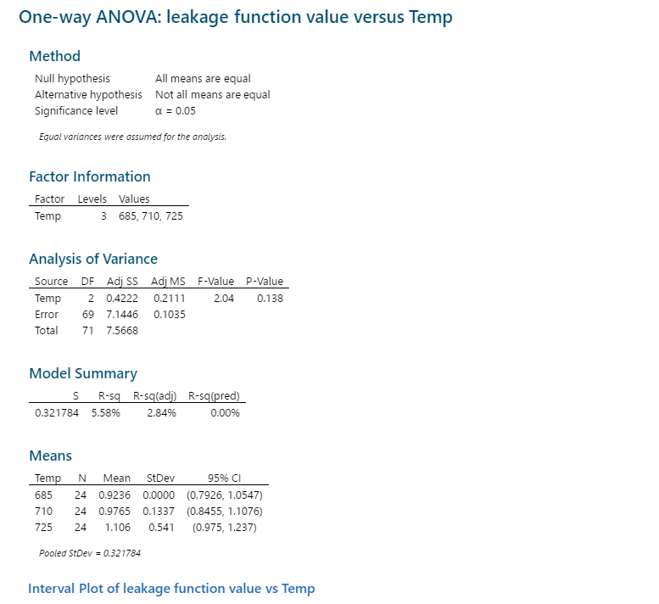
ANOVA ANALYSIS FOR TEMPERATURE AS FACTOR
MINIMUM VALUE OF THE LEAKAGE FUNCTION

Slide 17
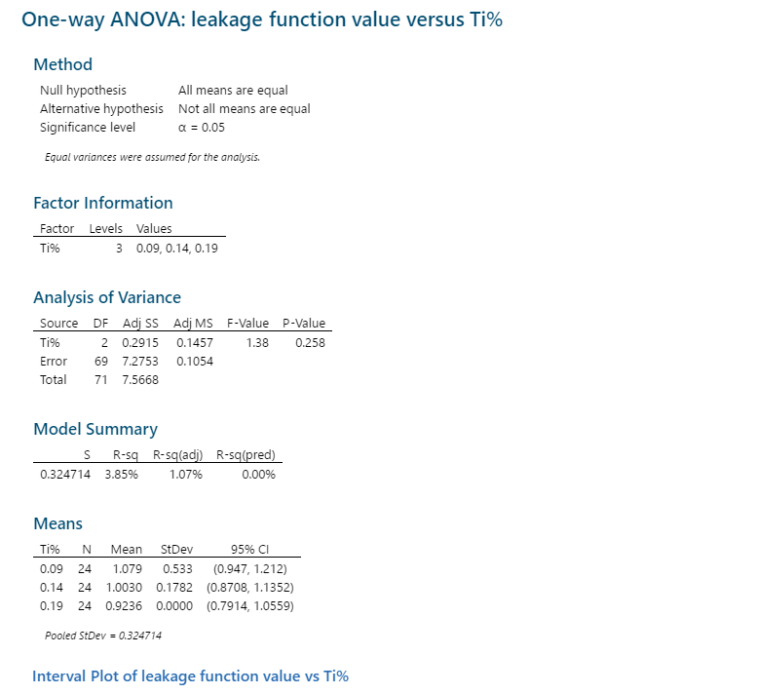
ANOVA ANALYSIS FOR TITANIUM% AS FACTOR
MINIMUM VALUE OF THE LEAKAGE FUNCTION

Slide 18
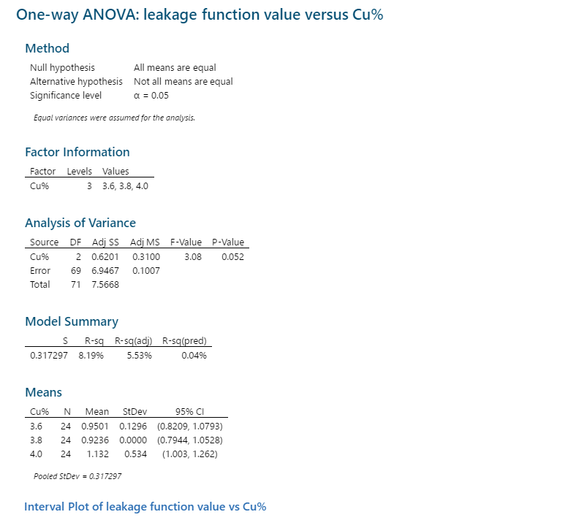
ANOVA ANALYSIS FOR COPPER% AS FACTOR
MINIMUM VALUE OF THE LEAKAGE FUNCTION

Slide 19

ANOVA ANALYSIS FOR SILICON% AS FACTOR
MINIMUM VALUE OF THE LEAKAGE FUNCTION

Slide 20
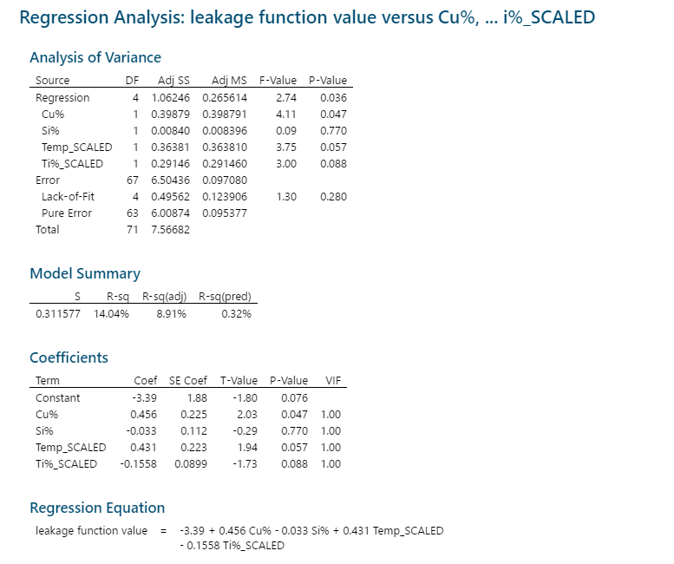
REGRESSION ANALYSIS
Dominance of factors is in the order as shown:
Cu% > Temperature > Ti% > Si%

Slide 21
SUMMARY
Optimum setting as found after analysis:
a) Temperature- 685 degree C
b) Cu%- 3.8%
c) Si%- 5.4%
d) Ti%- 0.19%
2. Dominance of factors is in the order as shown:
Cu% > Temperature > Ti% > Si%
3. For validating the above analysis a verification trial will be conducted.

